Slide 1
Telecommunications and Network Security Week5

Slide 2
OSI Model
Oh no…

Slide 3
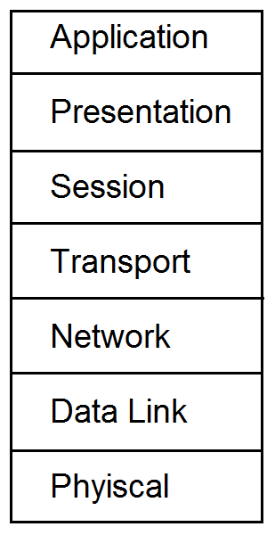
OSI

Slide 4
OSI model 485
7 layers
A P S T N D P… “All People Seem to Need Data Processing”… say that 10 times
Application
Presentation
Session
Transport
Network
Data link
Physical

Slide 5
OSI
Before we talk about network equipment we need to discuss the OSI framework briefly.
The OSI is a model of how network communications should be broken down into functional tasks. Each layer performs one task. It provides services to the layer above it, and uses services from the layer below it.
We say devices talk to each other at the same layer.

Slide 6
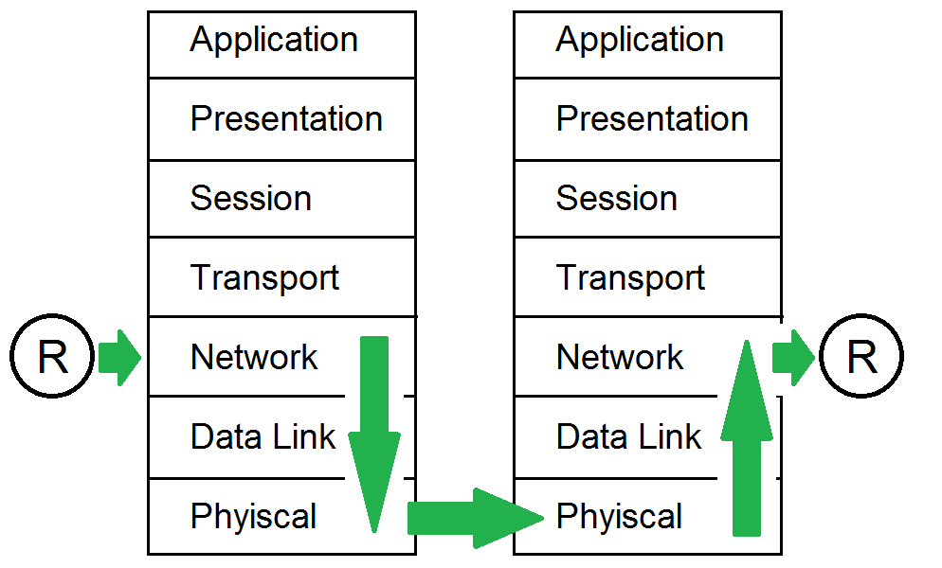
OSI

Slide 7
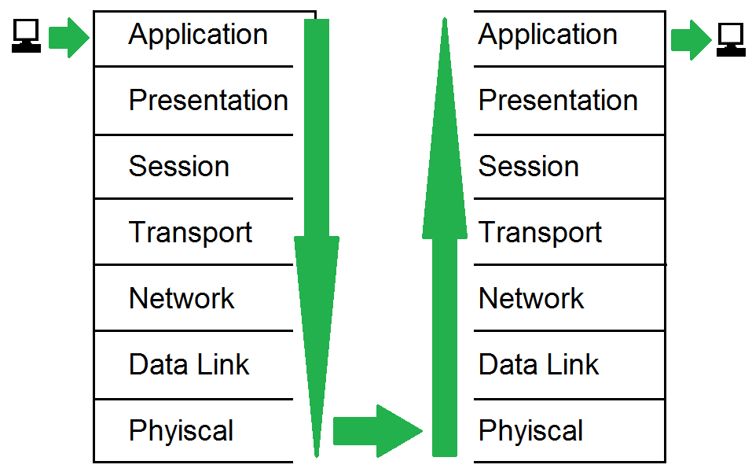
OSI

Slide 8
Quick OSI review
What layer is creates a connection between 2 applications?
What layer turns the frames sent to it into the proper voltages and timings to send across a wire?
What layer is concerned with finding paths between different networks?
What layer is concerned with the formatting of the data?
What layer is concerned with communicating between two of the? same interface types on computers on the same LAN?
What layer creates a connection between two computers?
What layer is concerned with the data/protocol that the application you are using uses?

Slide 9
TCP/IP model

Slide 10
TCP/IP Model (499)
No real network protocol is broken down into 7 layers.
Too much overhead
Almost all network communication now uses TCP/IP so we use the TCP/IP Model
Based on OSI model

Slide 11
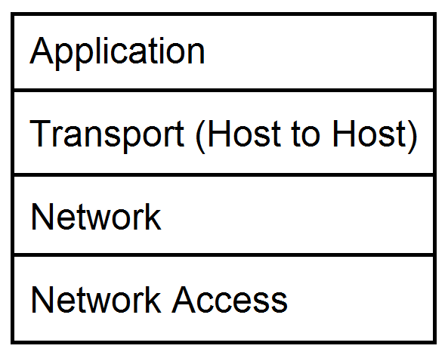
TCP/IP Model

Slide 12
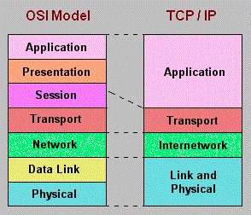
OSI vs. TCP/IP model

Slide 13
Some network equipment and what layers they generally work on
We will talk about these later on.
Hub/repeater – physical
Switch – data link
Router – network
firewall – can be one of many levels above network
Application proxy firewall – application

Slide 14
TCP/IP - 500
We currently use IPv4 with has 2^32 addresses
about 4 billion IP addresses
IPv6 has 2^128 addresses (4 billion x 4 billion)
IPv6 also has
a simplified format
additional features such as IPSEC. (talk about IP SEC later)

Slide 15
TCP/UDP - 498
TCP/UDP handle the transport and session layers. They setup a communications channel between two programs talking over the network
Programs talk via ports which are numbers that generally define what program/services you want to talk to (talk about this in a couple slides)
More on TCP/UDP in the next slides

Slide 16
TCP
Connection oriented “guaranteed” delivery.
Advantages
Easier to program with
Truly implements a session
Adds security
Disadvantages
More overhead / slower

Slide 17
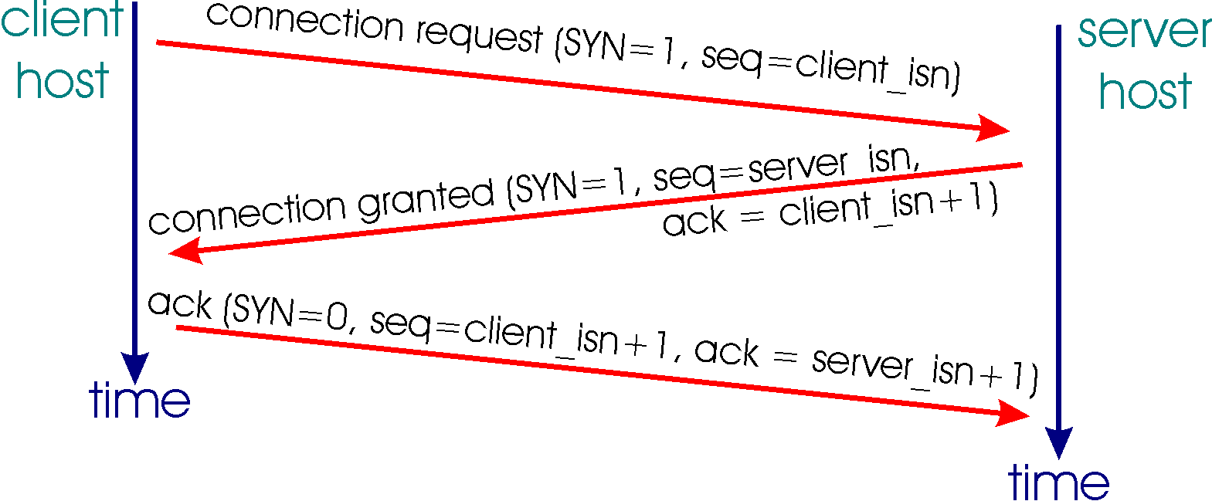
TCP - 504
Reliable connection-oriented protocol
Has a true connection
Starts with a 3-way handshake, (SYN, SYN-ACK, ACK)

Slide 18
TCP - 504
Keeps state, and will guarantee delivery of data to other side (or inform the application of the inability to send) does this with sequence and acknowledgement numbers, these numbers also provide ordering to packets
Has some security due to the state of the connection
Nice to program with, but slower/more overhead because of the work done to guarantee delivery.

Slide 19
UDP
Connectionless, non-guaranteed delivery (best effort)
Advantages
Fast / low overhead
Disadvantages
Harder to program with
No true sessions
Less security
A pain to firewall (due to no connections)

Slide 20
UDP - 500
Like a postcard, each packet is separate
No guarantee on delivery
Best effort
Fast, little overhead
No sequence numbers (ordering)
No acknowledgements
No connection
Security issues due to lack of a connection

Slide 21
Ports - 503
Both TCP and UDP use ports as the end points of conversations. Ports for services that are defined, and static are called well known ports some well know ports are*
telnet TCP/23
Email (SMTP) TCP/25
Email (POP) TCP/110
Email (IMAP) TCP/143
Web (HTTP) TCP/80
Web (HTTPS) TCP/443
DNS TCP & UDP 53
FTP TCP/21 & 20

Slide 22
Random Networking Terms - 512
Latency
Bandwidth
Synchronous – synchronized via a time source
Asynchronous – not timed
Baseband – use the entire medium for communication
Broadband – slide the medium into multiple channels for multiple simultaneous communications

Slide 23
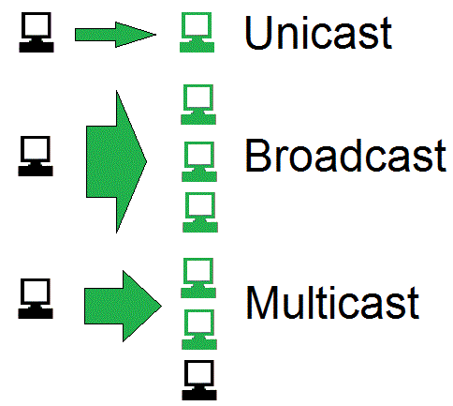
Random Networking Terms

Slide 24
Network Topologies

Slide 25
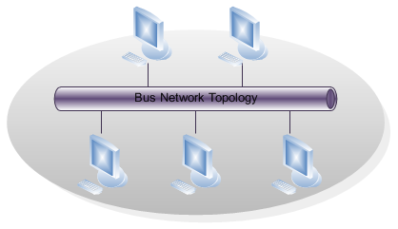
Bus (514)
Advantages?
Problems?

Slide 26
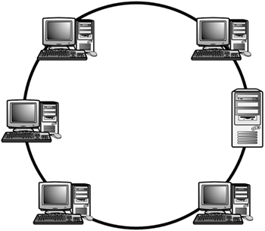
Ring (514)
Problems?
Advantages?

Slide 27
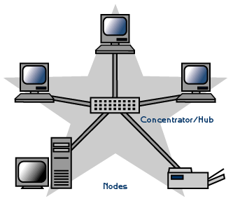
Star Topology (514)
Advantages?
Problems?

Slide 28

Mesh (515)
Advantages
Problems
Full Mesh =
(n(n-1))/2

Slide 29
Network Types

Slide 30
Ethernet - 517
Most common form of LAN networking, has the following characteristics
Shares media
Broadcast and collision domains (see next slides)
CSMA/CD
Supports full duplex with a switch
Defined by IEEE 802.3

Slide 31
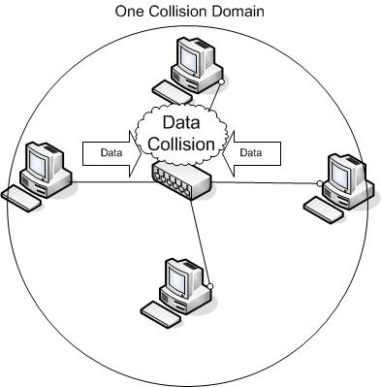
Collision Domain

Slide 32
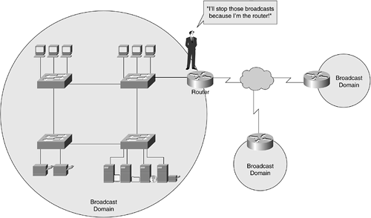
Broadcast Domain

Slide 33
Media Access Technologies (526)
Token Passing
CSMA/CD – waits for clear, then starts talking, detect collisions
CSMA/CA – signals intent to talk
Collision Domain – where collisions can occur. (i.e. two people try to talk at the same time)
What is a security impact of collision domains? sniffing, DoS

Slide 34
LAN Protocols - 529
ARP – Network Adapters have 2 addresses, and IP address, and a MAC address. (what is each used for? How do they relate? which “layer” does each exist on?)
ARP is the glue for relating the IP and the MAC addresses
Attacks
ARP table poisoning – what is this how does it happen, what would it do?

Slide 35
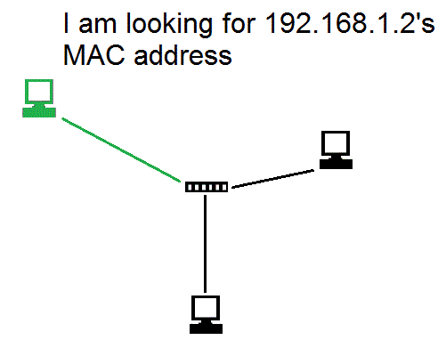
ARP (533)

Slide 36
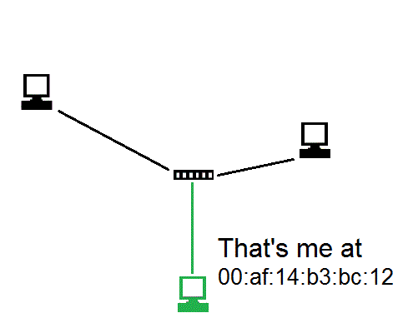
ARP (533)

Slide 37
DHCP - 534
DHCP – what is it what is it used for?
Precursors
RARP – what did it do?
BOOTP – what did it do?

Slide 38
Basic Networking Devices (541)
There are different types of networking devices that exist we will look at
Repeaters
Hubs
Bridges
Switches
Routers

Slide 39
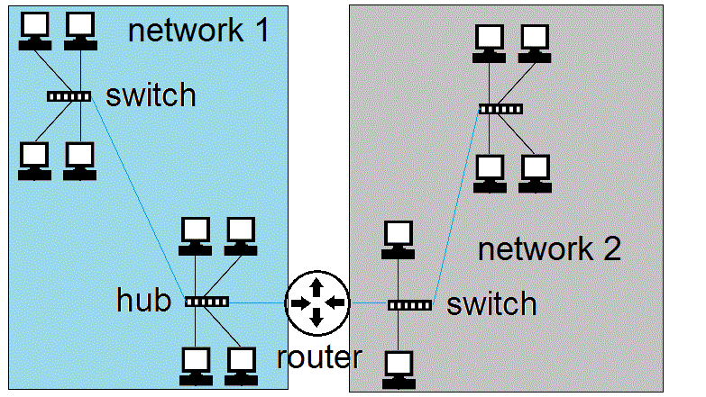
Router (544)
192.168.1.0 / 255.255.255.0 10.1.2.0 / 255.255.255.0
Routers create separate LAN networks. These networks will have different IP ranges

Slide 40
Routers vs. Switches - 546
You should understand the different between a router and a switch.
You should also know when you need a router and when you need a switch.
Also memorize the table at the top of 546

Slide 41
Advanced Networking Devices
These are devices that are beyond the basic fundamental networking devices, they generally provide some specific advanced functionality.
Gateway
PBX
Firewall* (multiple types)

Slide 42
Gateway - 550
Generic Term for something that connects two separate things together (can be any level).
Default gateway = router to get you off your network
Application gateways – work at the application level and help translate between two different applications (NFS <-> SMB).
Email Gateway – translate between different email types. (Exchange and SMTP)

Slide 43
PBX 552
Private Branch Exchange – phone system
Old systems analog*
New systems digital and VoIP
Crackers that hack phone systems used to be call phreakers*
Free calls (long distance)
Masquerade as other people/hide calls
Often this goes un-noticed as companies often do not audit their phone bills closely

Slide 44
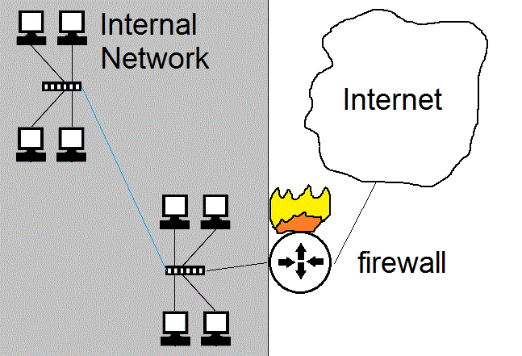
Firewall 553

Slide 45
Firewalls - 553
Enforce network policy.
Usually firewalls are put on the perimeter of a network and allow or deny traffic based on company or network policy.
MUST have IP forwarding turned off*
Firewalls are often used to create a DMZ.
Generally are dual/multi homed*
Types of firewalls
Packet filtering
State full
Proxy
Dynamic packet filtering

Slide 46
Packet filter - 555
Uses Access control lists (ACLs), which are rules that a firewall applies to each packet it receives.
Not state full, just looks at the network and transport layer packets (IP addresses, ports, and “flags”)
Do not look into the application, cannot block viri etc.
Generally do not support anything advanced or custom

Slide 47
Packet Filter
Packet filters keep no state*
Each packet is evaluated own it’s own without regard to previous traffic
Advantages
Disadvantages
fragments
Rule based access control
Packet filters are still used on the edge of the network before a statefull firewall for performance reasons.

Slide 48
State full firewall - 556
router keeps track of a connections in a table. It knows which conversations are active, who is involved etc.
It allows return traffic to come back where a packet filter would have to have a specific rule to define returned traffic
More complex, and can launch DoS against by trying to fill up all the entries in the state tables/use up memory.
If rebooted can disrupt conversation that had been occurring.
Context dependant access control*

Slide 49
Proxy firewalls - 557
Two types of proxies
Circuit level*
Application*
Both types of Proxies hide the internal hosts/addressing from the outside world.
Talk about each of these on next slides

Slide 50
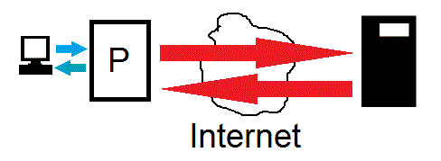
Circuit Level Proxy - 559
A middleman.
A proxy takes client information and sends it to a remote server, it also receives a response and sends it back to the client.

Slide 51
Circuit Level Proxies - 559
Main purpose is to hide internal network and stop direct communications between external machines and internal machines.
Advantages
Fairly simple
Works with all network protocols
Hides internal network addresses
When used with a firewall, stops people from directly starting conversations with internal hosts, while still allowing internal hosts to communicate with the Internet
Disadvantages
A single point of failure and performance issues
Does not analyze data does not protect from dangerous data
Cannot protect against, violations in the protocol or bad data being passed around,

Slide 52
Application Proxies - 559
Like circuit layer proxies, but actually understand the application/protocol they are proxing.
This allows for additional security as they can inspect the data for protocol violations or content.

Slide 53
Application Proxies - 559
Advantages
Application proxies understand the protocol, so they can add extra security
Can have advanced logging/auditing and access control features
Ex. Restrict users to only allowed websites
Ex. Inspect data for protocol violations
Ex. Inspect data for malware (viri etc)
Disadvantages
Extra processing requires extra CPU (slower)
Proxies ONLY understand the protocols they were written to understand. So you generally have a separate application proxy for EACH protocol you want to proxy

Slide 54
Application Proxies - 559
Examples:
Squid web proxy server
Internet Security and Acceleration Server (MS web proxy)
SMTP proxies
FTP proxies

Slide 55
NAT/PNAT
A proxy that works without special software and is transparent to the end users.
Remaps IP addresses, allowing you to use private addresses internally and map them to public IP addresses
NAT allows a one-to-one mapping of IP addresses
PAT allows multiple private address to share one public address

Slide 56
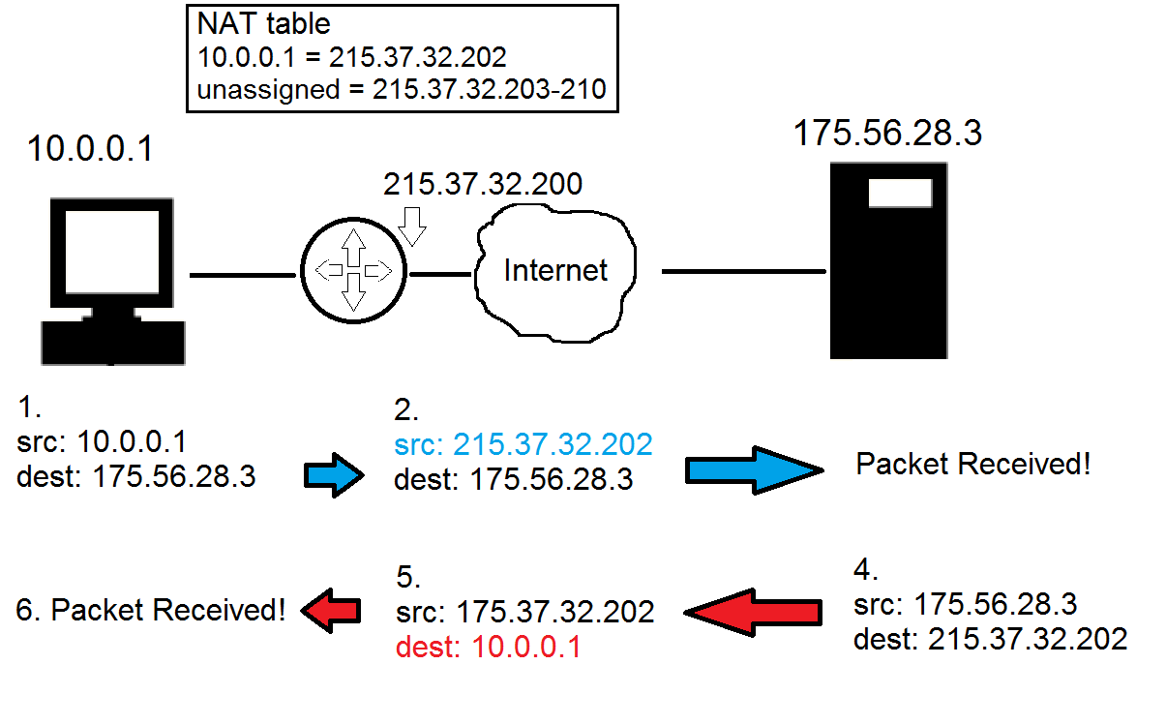
NAT

Slide 57
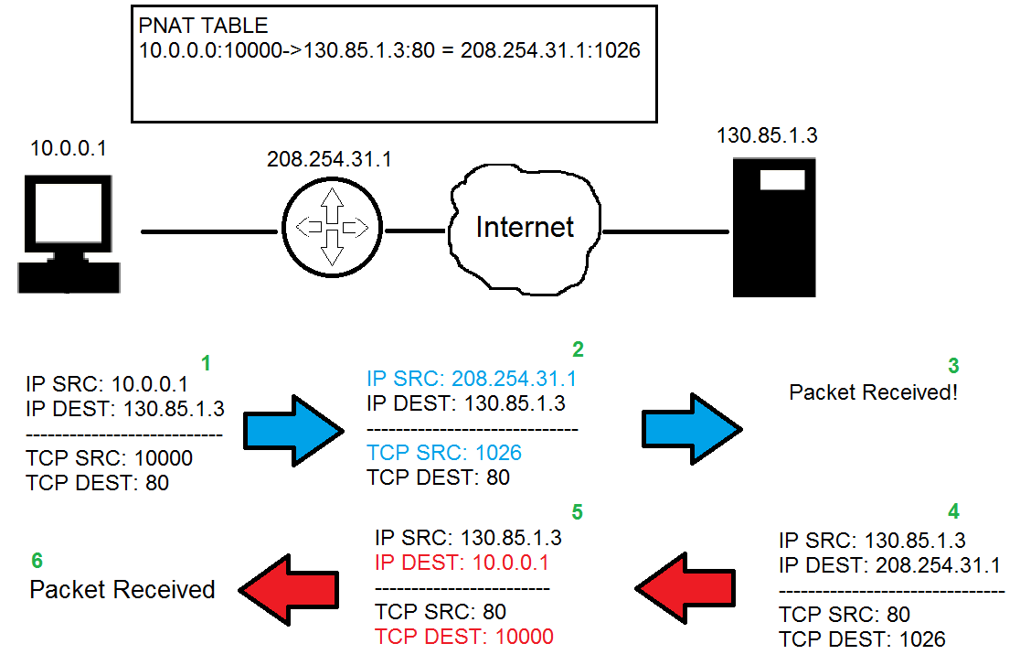
PNAT

Slide 58
NAT/PAT difference
NAT ONLY looks and rewrite the IP addresses*.
NAT requires 1 public IP for each computer that wants to access the Internet simultaneously. If you have 100 computer and you expect 20 of them to access the Internet at any time, 20 public IP addresses are required.
PAT looks at the IP and transport layer port number and rewrites both*
PAT only requires 1 public IP address and can support about 65,000 simultaneous connections for each IP public IP address.

Slide 59
NAT / PNAT
Advantages
Allows you to use private addresses Internally, you don’t need to get real public IP addresses for each computer
Protects the network by stopping external entities from starting conversations to internal machines
Hides internal network structure
Transparent, doesn’t require special software
Disadvantages
Single Point of Failure / Performance Bottleneck
Doesn’t protect from bad content

Slide 60
Overall Firewall best practices (563)
Block un-necessary ICMP packets types.
(Be careful though, know your environment)
Keep ACLS simple
Use Implicit deny*
Disallow source routed packets*
Use least privilege*
Block directed IP broadcasts
Perform ingress and egress filtering*
Enable logging
Drop fragments or re-assemble fragments

Slide 61
Overall Firewall issues
Potential bottleneck
Can restrict valid access
Often mis-configured
Except for application proxies firewalls generally do not filter out malware or improper content.
Don’t protect against internal attacks!*

Slide 62
Firewall Architecture

Slide 63
Security Zones
It is common practice in network and physical security to group different security levels into different areas or zones. Each zone is either more or less trusted then the other zones. Interfaces between zones have some type of access control to restrict movement between zones (like biometric and guard stations) or firewalls.) In Network security there is often a median zone between the Internet and internal network called a DMZ.

Slide 64
DMZ
A buffer zone between an unprotected network and a protected network that allows for the monitoring and regulation of traffic between the two.
Internet accessible servers (bastion hosts) are placed in a DMZ between the Internet and Internal network

Slide 65
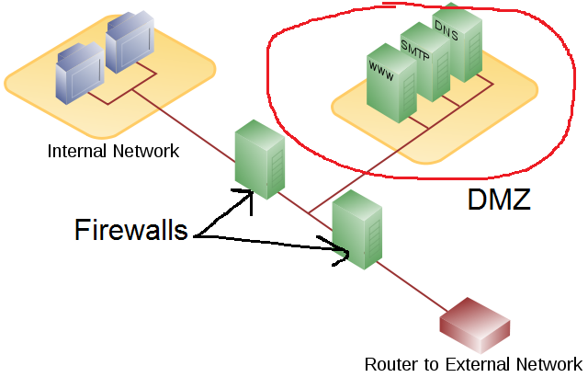
DMZ

Slide 66
DMZ architectures
Multi-homed Firewall
Screened Subnet

Slide 67
Multi Homed Firewall - 565
Multi-homed firewalls may be used to setup a DMZ with a single firewall. (see next slide)
On any multi-homed machine, IP forwarding should be disabled.*

Slide 68
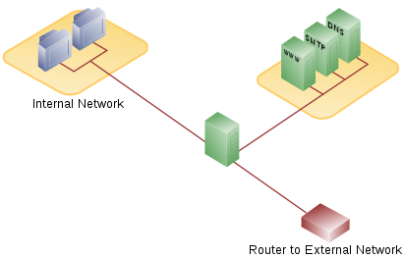
Multi-homed firewall

Slide 69
Screened Subnet - 566
In a screen subnet, there is a separate firewall on both sides of the DMZ.
When using this model it is recommended that each firewall be a different vendor/product.
Diversity of defense*

Slide 70
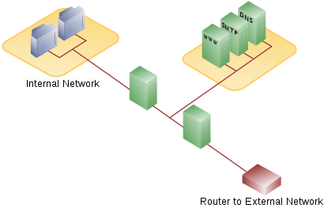
Screened Subnet

Slide 71
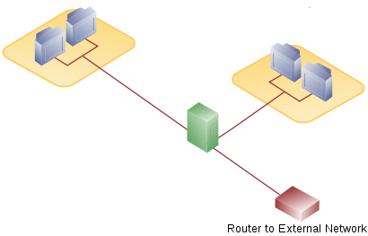
Multiple interface firewalls - 560
A firewall can be placed internally to protect internal networks from each other!

Slide 72
Other Random Network Terms

Slide 73
Other Technological security concepts (572)
Honey pot – a machine left open for attackers to attack.
Honey net – an entire network left open for attackers to attack.
Know the difference between entrapment and enticement?*

Slide 74
NOS (568)
NOS - Network Operating System. All modern OSes are NOS.
This just means they manage more than just the local computer, they usually provide or use network services in a client server architecture.

Slide 75
DNS - 574
Network software uses IP addresses, however these are difficult for users to remember (especially in IPv6). So DNS is used to help map names that we use such as www.paladingrp.com to addresses that computers use like 63.251.179.13

Slide 76
DNS
Common top level domains are
.COM
.EDU
.MIL
.GOV
.ORG
.NET
You should be aware of these above

Slide 77
DNS cache poisoning - 577
Besides authoritative name servers organizations also have caching name servers that simply do DNS resolution on behalf of clients.
One common attack is DNS cache poisoning*

Slide 78
DNS SEC
DNS sec tries to ensure integrity of DNS queries by digitally signing responses.* This attempts to defeat cache poisoning.

Slide 79
Intranet, Extranet - 582
Intranet – internal IP network, though often used to define a set of resources made available through a web interface for INTERNAL use
Extranet – a set of network resources (usually web based) for two companies to collaborate or share resources, may or may not make use of VPNs

Slide 80
LAN, WAN, MAN - 581
LAN – local area network
High speed
Small physical area
WAN – wide area network
Used to connect LANS
Generally slow, using serial links
MAN – metropolitan area network
Connect sites together within a medium range area (like a city)

Slide 81
Types of links for WANs and MANS
Dedicated/leased/point to point – a link that is pre-established and used ONLY for communications between 2 locations, it is DEDICATED (see next slide) to their use
Expensive, cost per distance
Types
T1 - about 1.5Mbs
T3 - about 45 Mbs
Fractional T – some fraction of a T1/T3
T1s are time division multiplexed*
T1s are annoying, because the local loop often fails
T1/T3 can also be used in shared/frame relay

Slide 82
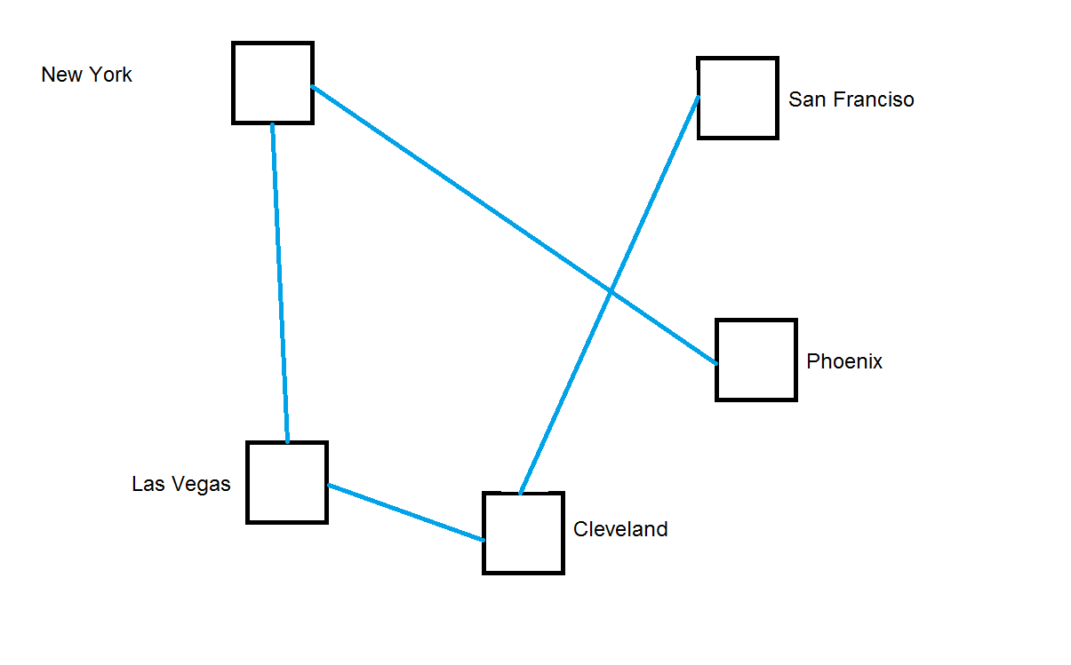
Dedicated (589)

Slide 83
Frame Relay - 595
Data link protocol (layer 2)
Not a point to point connection, but a connection into a cloud
CIR*
Uses virtual circuits (PVC)
Uses DLCIs*
Still uses T1/T3 but rather than going all the way, they just go to the carriers Point of Presence*.

Slide 84
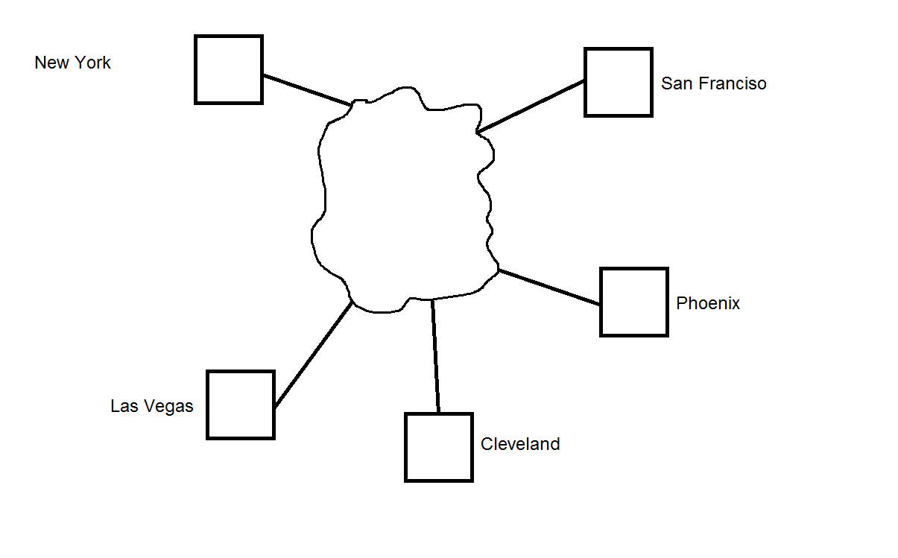
Frame relay / cloud

Slide 85
WAN terms

Slide 86
Multiplexing - 591
Time Division
Frequency Division
Wavelength Division
CDMA – speak multiple “languages” /mathematic multiplexing
* this is technically incorrect, but easy to understand the analogy

Slide 87
CSU/DSU - 592
Channel Service Unit / Data service Unit – effectively the modulator/ memodulator (modem) for serial lines.*

Slide 88
Circuit vs. Packet Switching - 594
Packet-based networking vs. circuit based
Packets are small, quick to send
Routes vary
Route determined after computer begins to send the packet
Can arrive from different routes in different order than sent.
Can introduce delays as packets traverse network, where as with circuit switching the delays is before data is sent (circuit/setup)*
Circuit switching – connection oriented/dedicated resources and circuit
Circuit switching has fixed delays.

Slide 89
Packet Switching (this should be automated)

Slide 90
ATM - 598
A type of packet based switching used to emulate circuit switching
Used by telcos
53 byte cells *
48 bytes data
5 bytes header
Sets up a virtual circuit
Guarantees resources once a circuit is setup*
Guarantees QoS*

Slide 91
QoS - 598
QoS
What is it
Why is it needed
Network convergence

Slide 92
VoIP - 602
VoIP
What are some concerns with VoIP
Technical
Latency, Jitter, dropped packets QoS
Security
Eavesdropping
Caller id Spoofing and vishing
Long Distance calls
SIP – Session Initialization Protocol
Call processor
Sets up calls, terminates calls.

Slide 93
Remote Access

Slide 94
Remote Access - 610
Home users/remote users need a way to access work
Dial Up
ISDN
DSL
Cable Modems

Slide 95
Dial up - 610
Advantages
Reduce networking costs (use internet) as opposed to dedicated connections
Allows work from home
Streamlines access to information
Provides a competitive advantage
(more)

Slide 96
Dial Up - 610
Disadvantages
Back door into networks (bypass firewall)
Often forgotten about
Slow
Attacks*
War dialing
Defenses*
Dial Back /
Caller ID restrictions
Use authentication
Answer after 4 or more rings (why/war dialing)

Slide 97
ISDN - 611
Uses same lines as phone lines, directly dial into company or ISP
BRI
2 B Channels (64Kbits x 2)
1 D Channel (control channel) Out of Band
PRI
23 B Channels
1 D Channel
Not for personal use

Slide 98
DSL - 613
MUCH faster than IDSN (6-30 times faster)
Must live very close to the DSL equipment
Symmetric and Asymmetric
Always on (security concerns)
Doesn’t connect directly to company
use VPN

Slide 99
Cable Modem - 613
High speed access up to 50Mbps via cable TV lines.
Shared bandwidth
Always on (security concerns)
Doesn’t connect directly to company
require VPN

Slide 100
VPNs

Slide 101

VPN
N

Slide 102
VPN - 615
Virtual Private Network – Generic term for building a secure virtual network over a public network
Often used for remote access for users
Often used to tie organizations remote offices together

Slide 103
Tunneling
A component of some VPNs - Tunnel encapsulates one protocol within another protocol to create a virtual network.
Can encrypts original IP headers
Can encrypts data
Allows for routing non routable protocols and IP addresses
Can provide remote/internal IP addresses

Slide 104
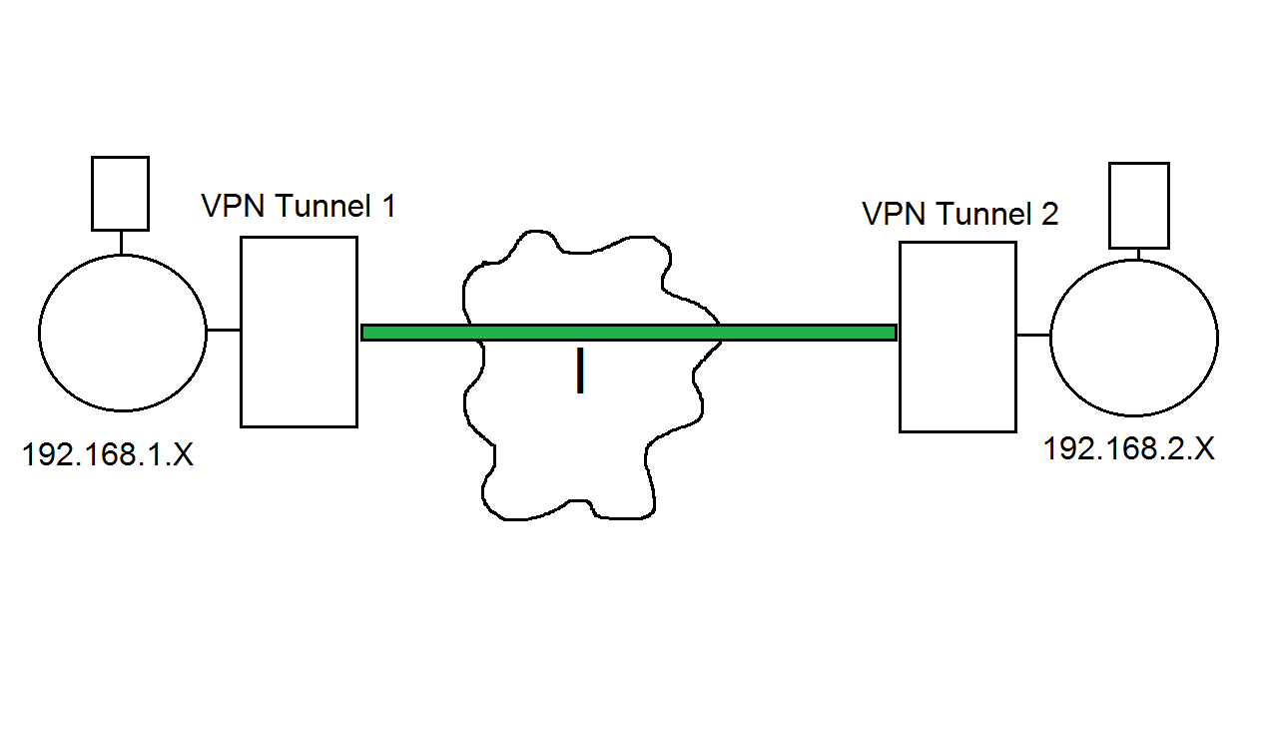
Example of Tunneling

Slide 105
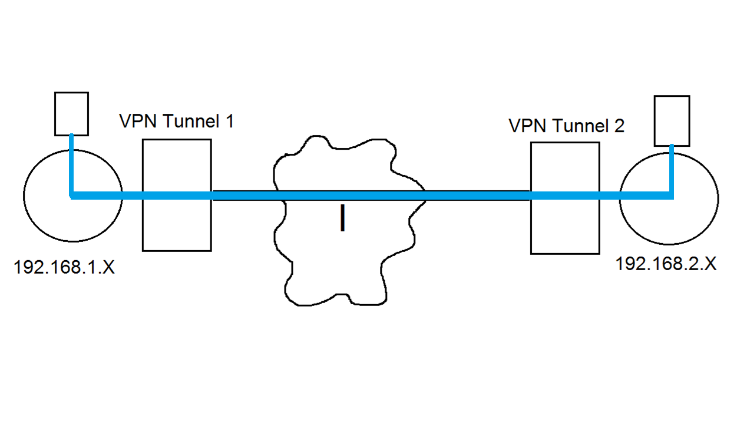
Example of Tunneling

Slide 106
Transport
Transport does not actually tunnel IP within IP. It only encapsulates the transport layer and above to protect the DATA.
Can encrypt DATA
Can provide origin authentication
Cannot encrypt original IP headers*
Does not provide remote/internal IP addresses*

Slide 107
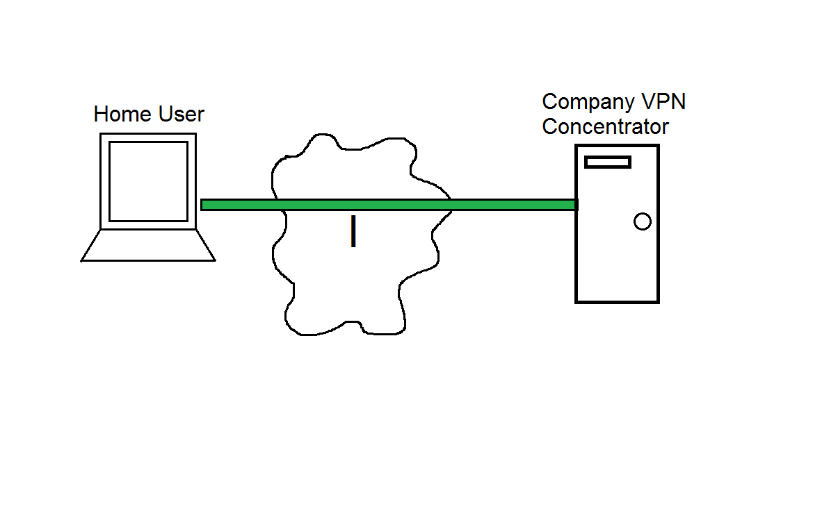
Example of transport

Slide 108
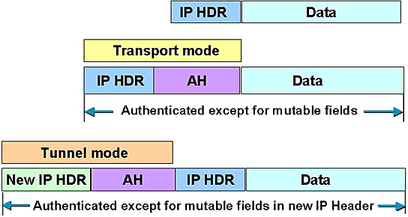
Transport vs. Tunnel

Slide 109
VPN protocols
Different protocols
PPTP
L2TP
IPSEC

Slide 110
PPTP - 619
Point to Point Tunneling Protocol
Lead by Microsoft protocol for a tunneling VPN
Uses TCP port 1723
must keep open on firewall*

Slide 111
PPTP operation
Remote user connects to ISP, get’s an Internet Address
Establishes VPN connection to work VPN server, get’s Internal IP address.
Sends private IP packets encrypted within other IP packets.
visualization next slide

Slide 112
L2TP
Layer 2 Transport Protocol
Cisco designed
Designed to be implemented in hardware
Does not provide encryption
UDP 1701

Slide 113
IP Sec - 617
Intended to add security to IPv6, back ported to IPv4
Can provide Integrity and Confidentiality as well as data origin authentication.
Uses additional headers
AH
ESP
Tunnel, or Transport
Uses Security Associations (SA)
Uses IP protocol 50 ESP headers, 51 for AH headers.
http://www.ciscopress.com/articles/article.asp?p=25477

Slide 114
IPSEC
AH - authentication header
Protocol number 51
Authentication only
ESP – Encapsulating security payload
Protocol number 50
Encryption

Slide 115
IP SEC SA
From Cisco:
The concept of a security association (SA) is fundamental to IPSec. An SA is a relationship between two or more entities that describes how the entities will use security services to communicate securely. IPSec provides many options for performing network encryption and authentication. Each IPSec connection can provide encryption, integrity, authenticity, or all three. When the security service is determined, the two IPSec peers must determine exactly which algorithms to use (for example, DES or 3DES for encryption, MD5 or SHA for integrity). After deciding on the algorithms, the two devices must share session keys. As you can see, there is quite a bit of information to manage. The security association is the method that IPSec uses to track all the particulars concerning a given IPSec communication session

Slide 116
IP Sec SA
Unidirectional, need two for bi-directional communication
SAs are identified by an SPI (Security Parameter Index )
Dynamic protocol for establishing SA and keys in IPSEC is ISAKMP
UDP port 500

Slide 117
Remote Access Best Practices
Always authenticate users
Use multi-factor authentication
Audit access
Answer modems after 4 rings (modems)
Use caller id (modems)
Use callback (modems)
use VPNs

Slide 118
Wireless

Slide 119
Wireless (625)
Wireless, very common now.
No wires
Easy to use
Uses CSMA/CA
Shared Medium
Problems?

Slide 120
Spread Spectrum - 625
Spreads communication across different frequencies available for the wireless device.
Frequency Hopping Spread Spectrum
Hop between frequencies (helps if other devices use same frequencies) (doesn’t use the entire “bandwidth of frequencies)
Harder for eavesdroppers (if everybody didn't know the sequence.. Which they actually do)
Direct Sequence Spread Spectrum
Sends data across entire bandwidth, using chipping code* along with data to appear as noise to other devices.

Slide 121
Wireless Components - 627
Access points are like wireless hubs, they create a infrastructure WLAN
If you use just wireless cards of computers to communicate together that is called an ad-hoc* network.
Wireless devices must use the same channel
Devices are configured to use a specific SSID (often broadcasted)

Slide 122
802.11 standard - 630
Wireless networking
2.4, 3.6, 5 GHz
Data Link layer specifications
Access point (a type of bridge)

Slide 123
802.11 family - 630
802.11a
54Mbps
5Ghz
8 channels
802.11b
11Mbs
2.4Ghz (same as other home devices)
802.11g
54Mbs
2.4Ghz
802.11n
100Mbs
2.4Ghz or 5Ghz

Slide 124
Wireless security problems
Unauthorized access
sniffing
War driving
Unauthorized access points (Man in the middle)

Slide 125



Airsnarfing (wireless MiM)
Wireless AP
Wireless User
Attacker

Slide 126
Transmission encryption – 632
There are many different types of wireless encryption protocols
WEP
Shared authentication passwords
64 or 128 bit
Easily crackable
Only option for 802.11b
WPA PSK
Shared authentication password
TKIP

Slide 127
Transmission Encryption
WPA2 PSK
Shared authentication password
AES
WPA and WPA2 Enterprise
Uses 802.1X authentication to have individual passwords for individual users
RADIUS – what was radius again?
802.11i* – the official IEEE wireless security spec, WPA2 supports 802.11i

Slide 128
802.1X - 627
Authenticated port based access control.
Provides distinct user authentication
Has supplicant (client), authenticator (AP) and authentication service (usually radius)

Slide 129

Bluetooth

Slide 130
Bluetooth (640)
Bluetooth is a Personal Area Network protocol designed to free devices from physical wires.
Bluetooth Modes
Discovery Mode
Automatic Pairing

Slide 131
Bluetooth Attacks
Blue jacking
Sending forged message to nearby bluetooth devices
Need to be close
Blue Snarfing
Copies information off of remote devices
Blue bugging
More serious
Allows full use of phone
Allows one to make calls
Can eavesdrop on calls

Slide 132
Bluetooth Countermeasures
Disable it if your not using it
Disable auto-discovery
Disable auto-pairing

Slide 133
WAP (641)
Wireless Application Protocol – a protocol developed mainly to allow wireless devices (cell phones) access to the Internet.
Requires a Gateway to translate WAP <-> HTML (see visual)
Uses WTLS to encrypt data (modified version of TLS)
Uses HMAC for message authentication
WAP GAP* problem (see visual and explain)
A lot of wireless devices don’t need WAP anymore.

Slide 134
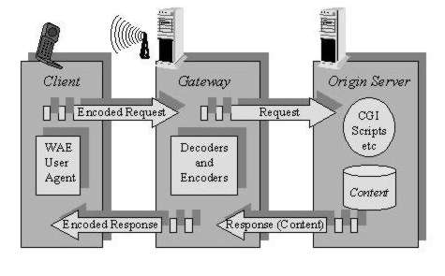
WAP

Slide 135
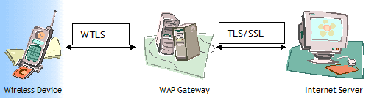
WAP GAP
As the gateway decrypts from WTLS and encrypts as SSL/TLS, the data is plaintext. If someone could access the gateway, they could capture the communications

Slide 136
Attacks against Networks and Software

Slide 137
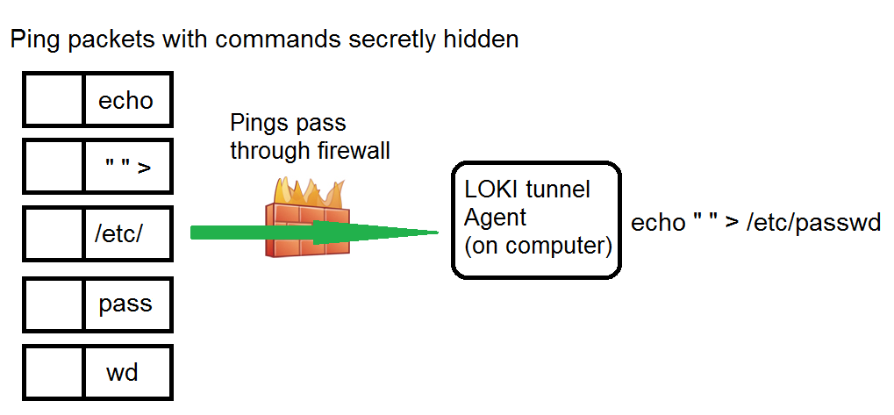
LOKI
Pings easily go through the firewalls undetected!

Slide 138
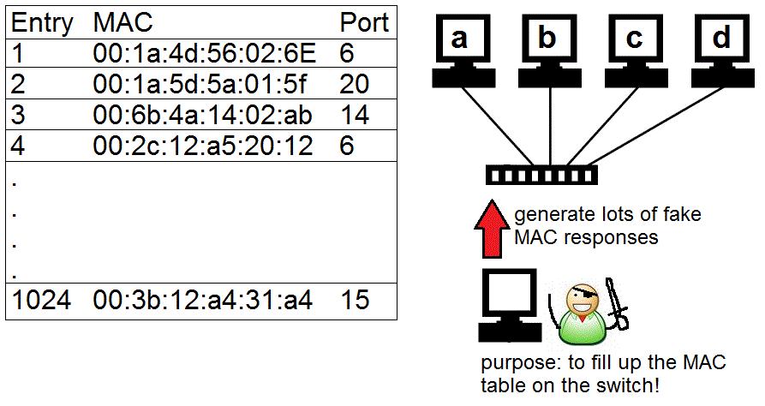
MAC flooding

Slide 139
Buffer Overflows (chapter 11)
What are they? What are the attributes of a buffer overflow?
NOTE SERIOUS LIBERTIES have been taken with the example slides of a buffer overflow to simplify the attack so it’s easier to understand. In reality it’s more complicated than shown

Slide 140
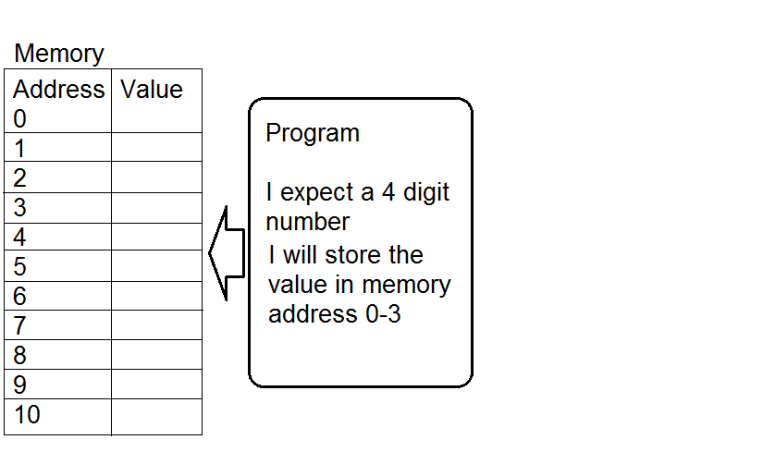
Buffer Overflow

Slide 141
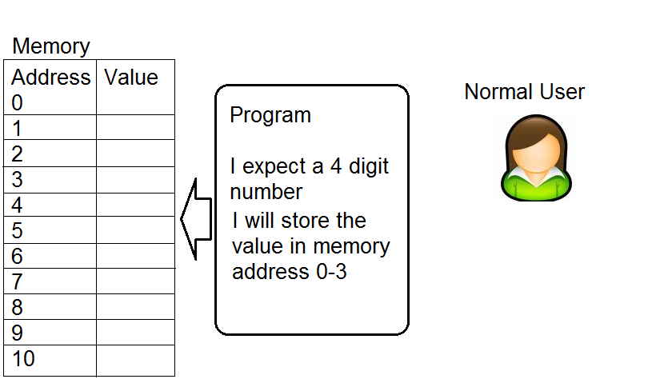
Buffer Overflow

Slide 142
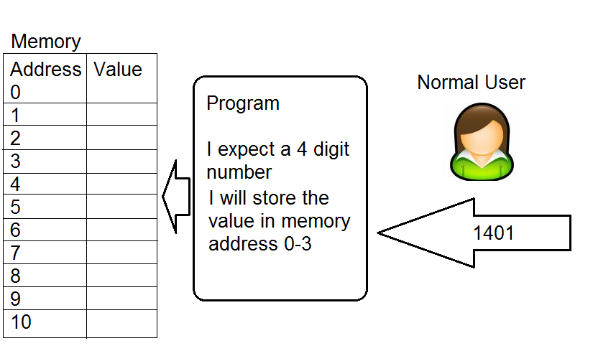
Buffer Overflow

Slide 143
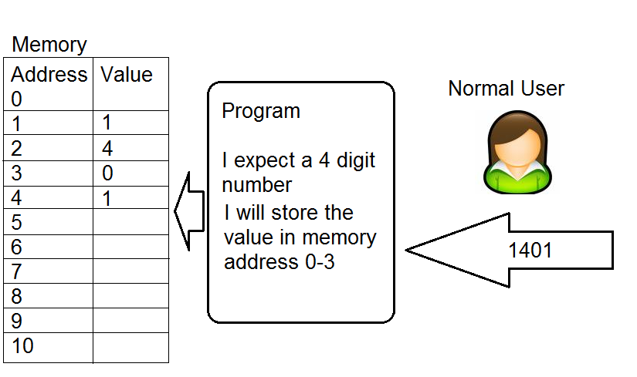
Buffer Overflow

Slide 144
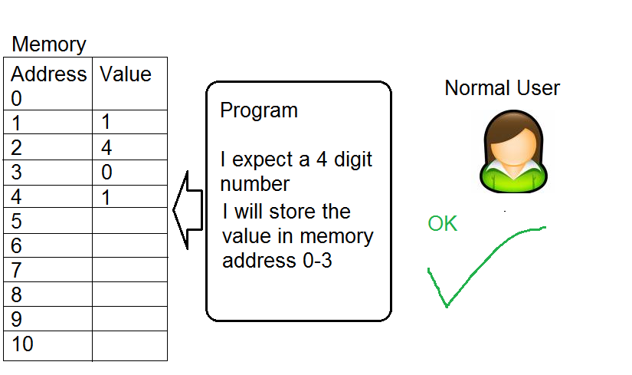
Buffer Overflow

Slide 145
Buffer Overflow

Slide 146
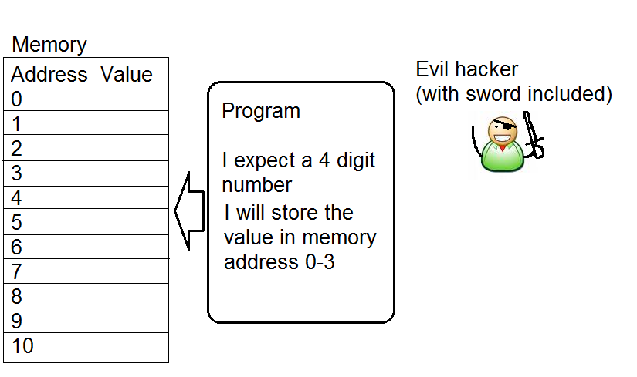
Buffer Overflow

Slide 147
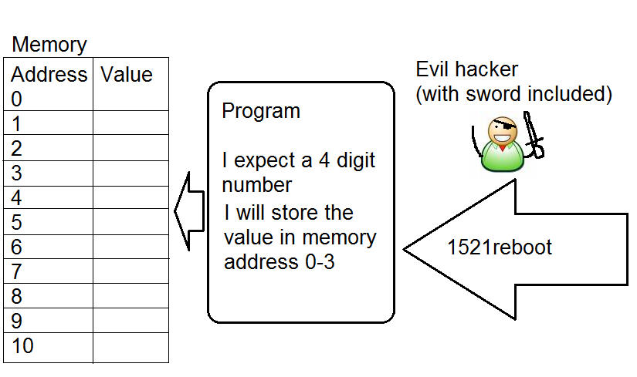
Buffer Overflow

Slide 148
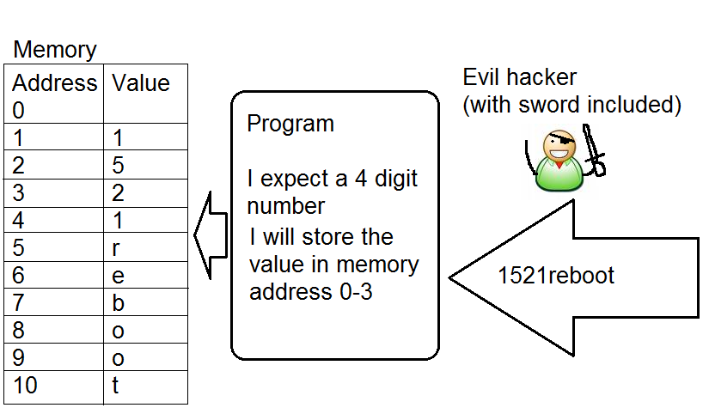
Buffer Overflow

Slide 149
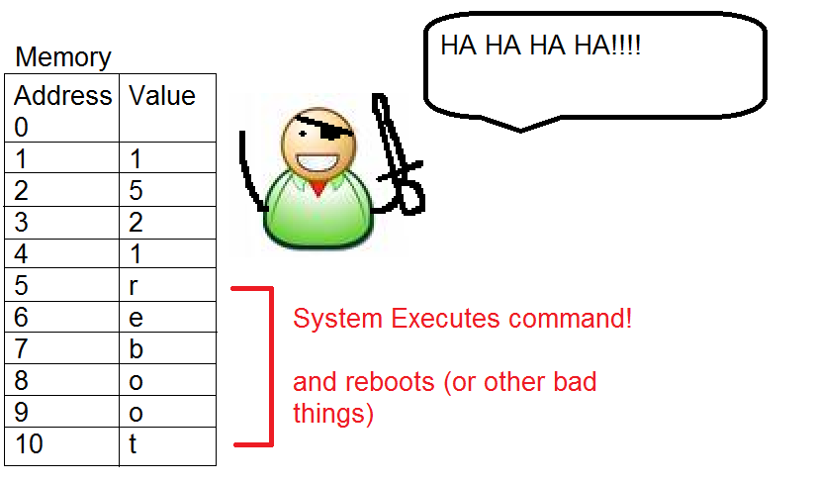
Buffer Overflow

Slide 150
Buffer Overflow
The previous example as shown was closer to command injection.
A real stack based buffer overflow would replace the reboot command with the machine code to make the system reboot, as well as over writing the return pointer on the stack with the address of the inserted machine code that would reboot the computer.

Slide 151
Buffer Overflows
Common buffer overflow types
Stack based
Heap based

Slide 152
Buffer Overflow
Best Defense against buffer Overflows
Educate software engineers with secure coding practices including input validation
Patching and making sure code is latest version (systems administrators)

Slide 153
Buffer Overflow
Buffer overflow defense unlikey to be seen on the exam.
Stack Canaries (compilers)
Non-executable stack and non-executable memory sections
NX bit
DEP
Address Space Layout Randomization (ASLR)

Slide 154

Smurf Attack

Slide 155
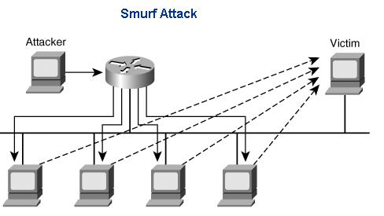
Smurf Attack (chapter 11 – 1031)

Slide 156
Smurf Attack
How would a smurf attack someone?
Find site to attack, say www.ebay.com
Forge Ping packet from www.ebay.com to a BROADCAST network address
Watch as the computers on the network all start pinging back www.ebay.com
Countermeasures
Drop forged packets at routers
Drop directed broadcasts at routers or end system
Use and IDS

Slide 157

Fraggle

Slide 158
Fraggle (like Fraggle rock) (chapter 11 – 1031)
Like Smurf, but uses UDP (echo and chargen)
Countermeasures
Drop forged packets at routers
Drop directed broadcasts at routers or end system
Disable echo and chargen services
Block echo and chargen ports on router
Use an IDS

Slide 159
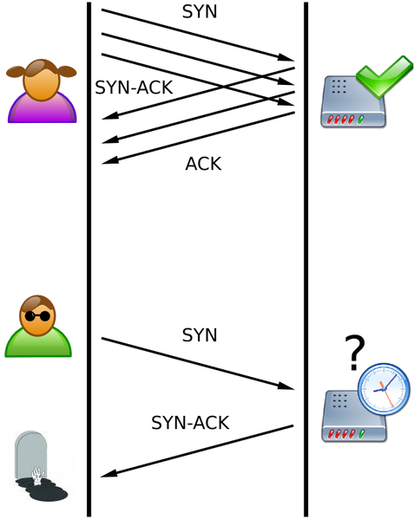
SYN Flood (chapter 11 – 1033)

Slide 160
SYN Flood
Attack
Forge IP SYN packet from downed system
Server responds to fake downed address, which never responds
Use up all the listen queue slots
Stops real new connections from establishing
Countermeasures
Drop forged packets at routers
Patch OS
Decrease 3 way handshake timeout values
Increase 3 way handshake max connections
Use a firewall as a middleman

Slide 161
Ping of Death

Slide 162
Session Hijacking

Slide 163
Tear Drop
Overlapping fragments, cause OS to get confused and crash.
Countermeasures
Patch the OS
Drop fragments (problems?)
Use a firewall that does fragment re-assembly.

Slide 164
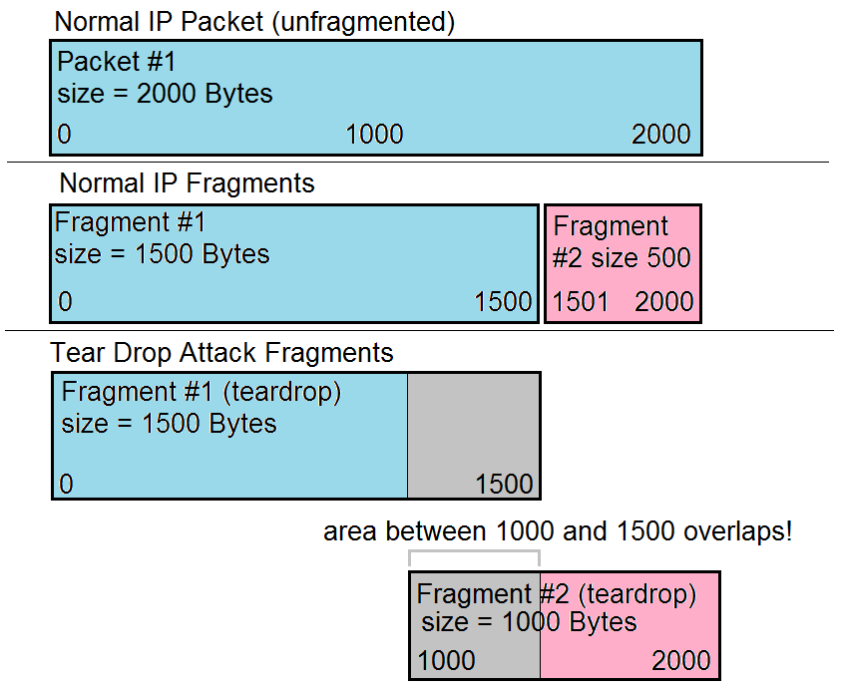
Tear Drop (chapter 11 – 1034)

Slide 165
LAND attack
Forging a SYN packet from a host to itself. Causing an loop of constant response to itself.

Slide 166
DDoS (chapter 11 – 1034)
Distributed Denial of Service – a brute force method that generally uses zombies or bots to build a botnet to overwhelm a target.
May consist of a hierarchy of Attacker, Masters and Slaves (see image 2 slides)

Slide 167
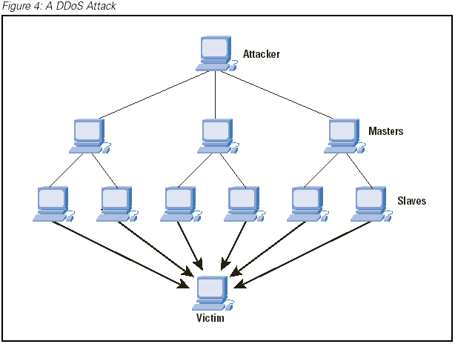
DDoS

Slide 168
DDoS
How are zombies and botnets usually created?

Slide 169
Maintenance Hooks (382) (chapter 5)
A backdoor that software developers put into the code so they can easily access a system for the purpose of troubleshooting.
Countermeasures
Code reviews by 3rd parties, if source code is available
Use an IDS system to detect backdoors/maintenance hook usage
Auditing (same as above)

Slide 170
Time of Check/Time of Use Attack (383)
A situation where the outcome of a command or processes are dependant on when certain steps are done.
Example.
Imagine I have $50.00 in an online gambling account. I say “bet all that’s in my account” on a football game tonight. After I place the bet I insert an additional $500.00 to my account. If for some reason that deposit gets in before the bet goes though, I might end up betting $550.00 when I only meant to bet $50.00

Slide 171
Time of Check/Time of Use Attack (383)
Countermeasures
Do not split up critical tasks into pieces (make transactions atomic
Lock out resource access to new operations while a current operation is running.
Basic database concept of transactions
Race conditions are a time of ToC/ToU attack.

Slide 172
Root Kit (649)
What is a root kit?
What is the purpose of a root kit?

Slide 173
Chapter 7 - Review
Q. What is blue jacking?
Q. What is TKIP?
Q. What can be used to defeat callback security?
Q. Why are switches more secure than hubs?

Slide 174
Chapter 7 - Review
Q. What is a Smurf Attack?
Q. What is a teardrop attack?
Q. What is a buffer overflow?
Q. what are used for DDoS attacks?
Q. Is TCP connection or connectionless?

Slide 175
Chapter 7 - Review
Q. does a switch create multiple
Collision Domains?
Broadcast Domains?
Q. What is an Advantage of a circuit level proxy? Disadvantage?
Q. What is an Advantage of a application proxy? Disadvantage?
Q. How many IP Sec SAs are required for communications between point A and point B?

Slide 176
Chapter 7 - Review
Q. what is a botnet?
Q. how does a SYN-flood attack work?

Slide 177
Chapter 7 - Review
Q. What layer of the OSI model does a switch work on? Hub? Router?
Q. What types of addresses do switches use for forwarding packets?
Q. What protocol and port does PPTP use?
Q. What is the best type of cable for high security or to avoid electrical interferance?

